Slide 1

Azure AD Account Linking in Teams Apps
Bob German Aditya Challapally

Slide 2
Why should Teams apps support Azure AD?
Allows single sign-on across devices – no extra login prompts!
Includes key security features like multi-factor auth and conditional access
Easier for users: no extra usernames or passwords to remember
Easier for team owners: no need to match M365 logins to app logins when assigning permissions
Easier for M365 admins: one place to disable access for departing team members
Required for monetization in the Teams store
Required for the M365 App Compliance program

Slide 3

Microsoft Azure Active Directory ”Single Sign-On in the cloud”
Azure subscriptions
Web browsers
Native applications
AuthN AuthZ
Microsoft 365
Daemon applications
Synchronise users from Active Directory on-premises
Azure Active Directory
Your apps
Tenant
Multi-tenant partner apps
Application gallery
Consent model
Conditional access
Self-service password, group management

Slide 4





















Microsoft 365
Subscription
Word
SharePoint
OneDrive
Users
Excel
Users
ToDo
PowerPoint
YOUR APP
Azure Active Directory
Guest users
Yammer
Teams
OneNote
Outlook
Tenant
Azure Active Directory

Slide 5









Azure AD
Existing
IdP
Microsoft Teams
SaaS Application
Microsoft Graph

Slide 6
Azure AD
Existing
IdP
Microsoft Teams
SaaS Application
SSO
Microsoft Graph
Identity Linking logic
Azure AD User ID | Existing IdP User ID
38e43097-cb13-42… | 1
a7775737-9a28-49… | 2

Slide 7


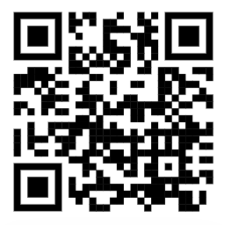

Teams App Camp
Core Lab (path A)
App setup
Add tab with SSO
Add look and feel
Core Lab (path B)
App setup
Add tab with SSO
Add look and feel
App setup no AAD
Migrate a non-Azure AD Web App to Teams
Migrate an Azure AD Web App to Teams
start
https://aka.ms/AppCamp
Personal tab w/Azure AD SSO
Core Teams Application
Extend capabilities
Configurable tab
Messaging Extension w/Adaptive Cards
Deep links
Task modules
Monetization
Tab in Meeting

Slide 8

Resources
Hands-on lab (“B Path”) | http://aka.ms/app-camp
Blog article | https://aka.ms/account-linking-article
Sample | https://aka.ms/account-linking-sample
Teams App Camp – on demand NOW http://aka.ms/app-camp
Teams App Camp LIVE EVENT October 20, 2022, 8-9am Pacific Registration now open at http://aka.ms/TeamsAppCamp

